Slide 1


Prva velika konferencija o solarnoj energiji u Srbiji
Balkan Green Energy News
14. april 2021

Slide 2
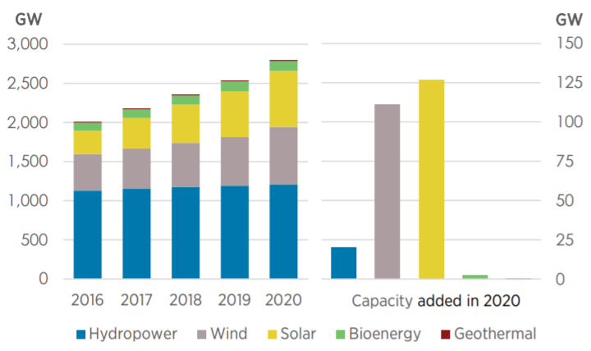

Global renewable power capacity growth
127 GW
(or +22%)
Solar PV
growth in 2020
Source: Renewable Capacity Statistics 2021, IRENA, March 2021

Slide 3
Electricity generated from solar PV in the EU
Fastest growing electricity source
Cumulative capacity in 2019 in the EU was 130,7 GW
Germany is leading
2010 - 2019
495%
Source: Eurostat, statista

Slide 4
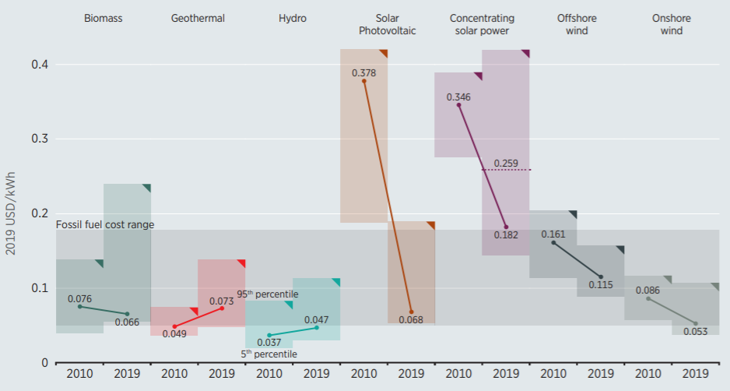

Global renewable power generation costs
LCOE reduction in the period
2010 - 2019
82%
Solar PV
Source: Renewable Power Generation Costs in 2019, IRENA, June 2020
* LCOE – Levelized Cost of Electricity

Slide 5
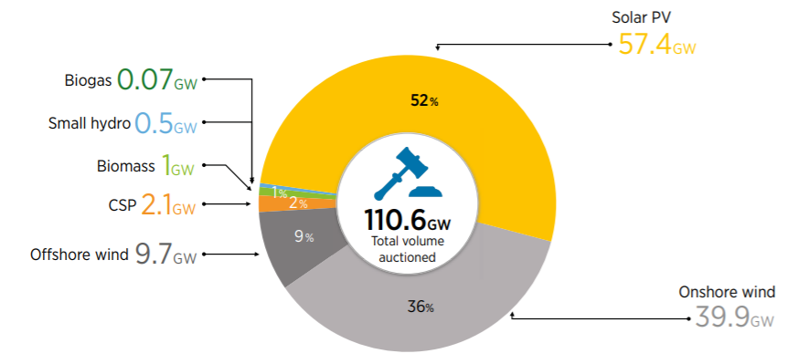
Share of the total volume of renewable energy auctioned in 2017-2018, by technology
World’s lowest price for solar electricity achieved in Abu Dhabi in 2020 was 0,0135$/kWh
EU’s lowest price was achieved in Portugal in 2019, 0,01476 €/kWh
Energy Community’s lowest prices: Albania 0,02489 €/kWh and North Macedonia’s premium on market price 0,004 €/kWh on state owned land
Source: Renewable energy auctions: Status and trends beyond price, IRENA, December 2019

Slide 6
Feed-in tariffs (EUR/MWh)
Contracting Parites |  | Solar PV |  | Onshore wind | Period (years) | Source
Federation of Bosnia and Herzegovina |  | 210 - 93 (23 kW - 1 MW) |  | 190 – 73 (23 kW – 10 MW) | 12 | Pravilnik o metodologiji o načinu utvrđivanja garantovanih otkupnih cijena električne energije iz postrojenja za korištenje obnovljivih izvora energije i efikasne kogeneracije. ODLUKA usvojena 10.12.2018.
Republika Srpska | FiT | On objects 110 - 77 (50 kW - 1 MW) | On the ground 87 (up to 250 kW) | - | 15 | ОДЛУКA о висини гарантованих откупних цијена и премија за електричну енергију произведену из обновљивих извора и у ефикаснoj когенерацији. 9.7.2019.
 | FiP | On objects 66 - 31 (50 kW - 1 MW) | On the ground 42 (up to 250 kW) | -
Kosovo* |  | 136,4 |  | 85 | 12 | DECISION, 16.05.2016.
Serbia |  | On objects 124 - 146 (0,03 – 0,5 MW) | On the ground 90 | 92 | 12 | УРЕДБA, 2016-2019

Slide 7
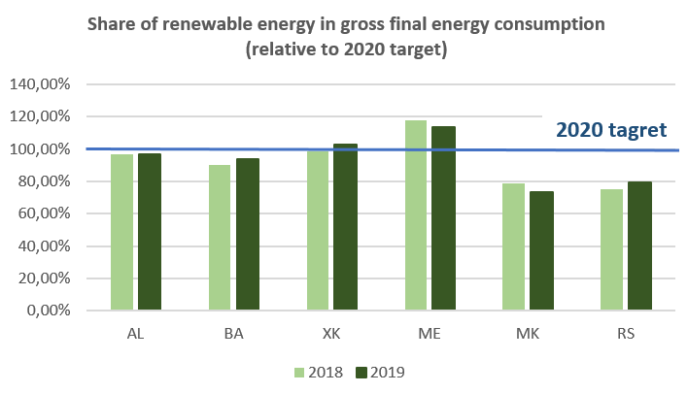
Serbia is far from reaching its 2020 renewable energy target, new, ambitious policies and measures are needed
Source: WB6 Energy Transition Tracker, Energy Community Secretariat, February 2021

Slide 8
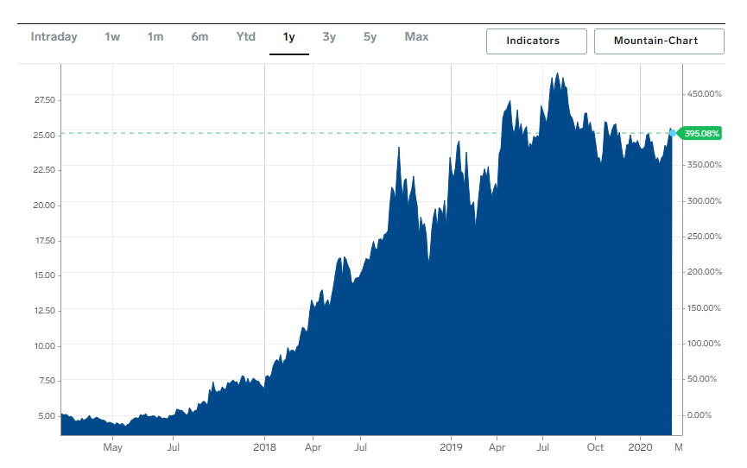
Green energy transition in EU is fueled by CO2 pricing
GG
With CO2 price of 25 EUR per ton of CO2 the polluters in power and heat sector would pay estimated 750 mill EUR annually, while price of 40 EUR/ton would amount to 1,2 billion EUR

Slide 9
New Law on Renewable Energy in Serbia
Law enables auctions for renewable electricity in line with the State Aid Guidelines, however detalis are yet to be elaborated in the secondary legislation
As part of the Integrated National Energy and Climate Plan (NECP), 2030 renewable energy target needs to be proposed as soon as possible to enable long-term indicative schedule for auctions
Law introduces self-consumption and energy communities
In the NECP, target for self-consumption needs to be proposed to boost deployment of small scale solar PV projects
Sophia Declaration, signed by President Vučić in November 2020 is commiting Serbia to transpose ETS Directive and introduce carbon pricing.

Slide 10
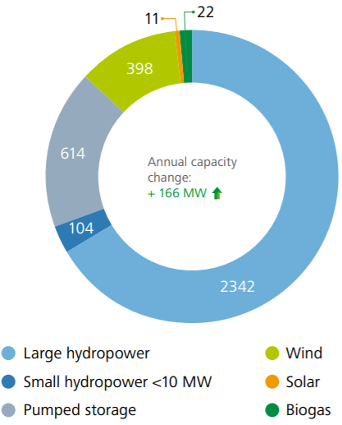
Total capacities of renewable energy in Serbia, 2019 (MW)
Only 11 MW installed solar PV capacities in Serbia in 2019
According to IRENA, potential for solar PV in Serbia in 2030 is 3582 MW
Source: Annual Implementation Report 2020, Energy Community Secretariat, November 2020
Renewable Energy Prospects for Central and South-Eastern Europe Energy Connectivity (CESEC), IRENA, October 2020

Slide 11

Thank you for your attention!
janez.kopac@energy.community.org
www.energy-community.org
Ener_Community
/company/energy-community
/Ener.Community
/EnergyCommunityTV
GET IN TOUCH

